Slide 1
MongoDB - Replication
Replication is the process of synchronizing data across multiple servers.
Replication provides redundancy and increases data availability with multiple copies of data on different database servers.
Replication protects a database from the loss of a single server. Replication also allows you to recover from hardware failure and service interruptions. With additional copies of the data, you can dedicate one to disaster recovery, reporting, or backup.
Why Replication?
To keep your data safe
High (24*7) availability of data
Disaster recovery
No downtime for maintenance (like backups, index rebuilds, compaction)
Read scaling (extra copies to read from)
Replica set is transparent to the application

Slide 2
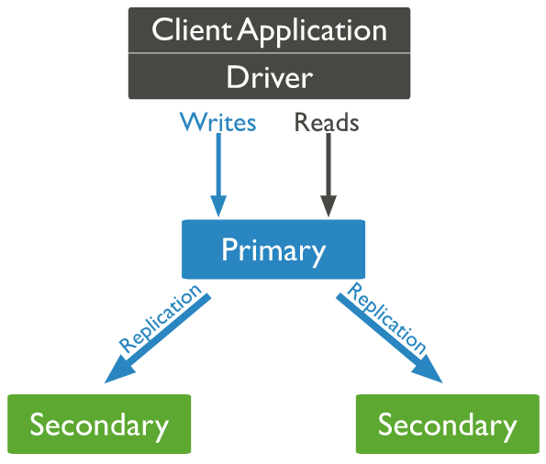

MongoDB - Replication
MongoDB achieves replication by the use of replica set. A replica set is a group of mongod instances that host the same data set.
In a replica, one node is primary node that receives all write operations. All other instances, such as secondaries, apply operations from the primary so that they have the same data set.
Replica set can have only one primary node.
Replica set is a group of two or more nodes (generally minimum 3 nodes are required).
In a replica set, one node is primary node and remaining nodes are secondary.
All data replicates from primary to secondary node.
At the time of automatic failover or maintenance, election establishes for primary and a new primary node is elected.
After the recovery of failed node, it again join the replica set and works as a secondary node.
A typical diagram of MongoDB replication is shown in which client application always interact with the primary node and the primary node then replicates the data to the secondary nodes.
Oplog

Slide 3
MongoDB - Replication
Replica Set Features
A cluster of N nodes
Any one node can be primary
All write operations go to primary
Automatic failover
Automatic recovery
Consensus election of primary

Slide 4
MongoDB - Replication
Here we will convert standalone MongoDB instance to a replica set. To convert to replica set, following are the steps −
Shutdown already running MongoDB server.
Start the MongoDB server by specifying -- replSet option. Following is the basic syntax of --replSet −
mongod --port "PORT" --dbpath "YOUR_DB_DATA_PATH" --replSet "REPLICA_SET_INSTANCE_NAME"
mongod --port 27017 --dbpath "D:\set up\mongodb\data" --replSet rs0
It will start a mongod instance with the name rs0, on port 27017.
Now start the command prompt and connect to this mongod instance.
In Mongo client, issue the command rs.initiate() to initiate a new replica set.
To check the replica set configuration, issue the command rs.conf(). To check the status of replica set issue the command rs.status().

Slide 5
MongoDB - Replication
Add Members to Replica Set
To add members to replica set, start mongod instances on multiple machines. Now start a mongo client and issue a command rs.add().
Syntax
>rs.add(HOST_NAME:PORT)
>rs.add("mongod1.net:27017")
Suppose your mongod instance name is mongod1.net and it is running on port 27017. To add this instance to replica set, issue the command rs.add() in Mongo client.
You can add mongod instance to replica set only when you are connected to primary node. To check whether you are connected to primary or not, issue the command db.isMaster() in mongo client.

